Slide 1
Evaluating Campaign Finance
50% Chance of Awesome
Timothy Ahn
Arif Ali
John Hotchkiss
Joshua Kaplan
Hongkai Wu

Slide 2
Outline
Motivation
Data
Research Questions and Related Analyses
Opportunities for Future Research
Wrap-up

Slide 3
Campaign Financing Issue
“[Our campaign funding system is] a corrupt system of legalized bribery with candidates begging for contributions from the wealthy and powerful.”
– Bernie Sanders, 2016 Democratic Presidential Candidate
“When you give, they do whatever the hell you want them to do.”
– Donald Trump, 2016 Republican Presidential Candidate

Slide 4
Data

Slide 5
Data Sources
Open Secrets
FEC
New York Times
Yahoo Finance via Quandl

Slide 6
Summary Statistics
Data with outliers
Year | Count | Party | Count | Winner | Count
2004 | 5634 | Democrat | 15539 | 0 | 14385
2006 | 5795 | Republican | 18284 | 1 | 20697
2008 | 5580 | Independent | 1259
2010 | 6184 |  |  | Incumbent | Count
2012 | 5885 |  |  | 0 | 16022
2014 | 6004 |  |  | 1 | 19060
Variable | Min. | 1st Qu. | Median | Mean | 3rd Qu. | Max. | Std. Dev. | NA's
Amount | 10 | 10000 | 35950 | 122100 | 115600 | 8829000 | 296218.9
Industrypercent | 0.001293 | 0.033 | 0.08094 | 0.1538 | 0.1984 | 1 | 0.1839325
Candtotal | 10 | 198600 | 566300 | 865900 | 961700 | 21830000 | 1358704
Votes | 5 | 88960 | 125400 | 194000 | 174300 | 7865000 | NA | 431
Percent | 0 | 0.3915 | 0.55 | 0.5289 | 0.6602 | 1 | NA | 431
Totalracefunds | 72620 | 584500 | 907700 | 1714000 | 1743000 | 32870000 | 2588232
Racefundperc | 0.00001 | 0.1867 | 0.6948 | 0.5985 | 0.9842 | 1 | 0.3843594

Slide 7
Summary Statistics
Data without outliers
Year | Count | Party | Count | Winner | Count
2004 | 4752 | Democrat | 13239 | 0 | 11776
2006 | 4688 | Republican | 15794 | 1 | 17450
2008 | 4705 | Independent | 193
2010 | 5241 |  |  | Incumbent | Count
2012 | 5042 |  |  | 0 | 13608
2014 | 4798 |  |  | 1 | 15618
Variable | Min. | 1st Qu. | Median | Mean | 3rd Qu. | Max. | Std. Dev.
Amount | 49 | 8100 | 29000 | 75040 | 88750 | 1379000 | 120266.7
Industrypercent | 0.001293 | 0.03269 | 0.07939 | 0.1538 | 0.1947 | 1 | 0.1865573
Candtotal | 100 | 140300 | 509900 | 546000 | 813300 | 1720000 | 428264.7
Votes | 3713 | 85110 | 120100 | 123400 | 162400 | 259500 | 53989
Percent | 0.0008 | 0.385 | 0.5551 | 0.5295 | 0.6658 | 1 | 0.1999814
Totalracefunds | 72620 | 554900 | 826400 | 1151000 | 1378000 | 22530000 | 1271807
Racefundperc | 0.000012 | 0.1557 | 0.696 | 0.5889 | 0.9845 | 1 | 0.3921799

Slide 8
Question 1:
Do campaign contributions predict electoral success?

Slide 9
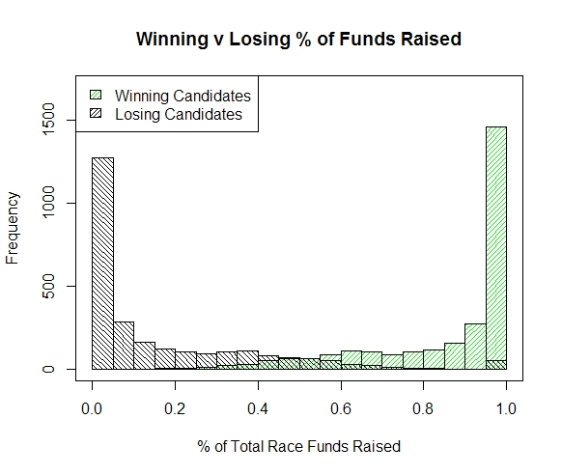
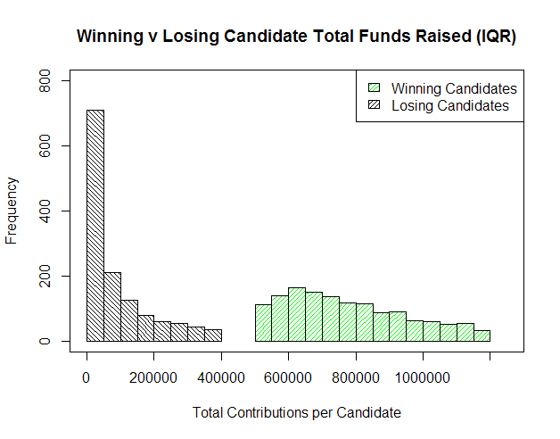
Winning candidates raise more money than losing candidates

Slide 10

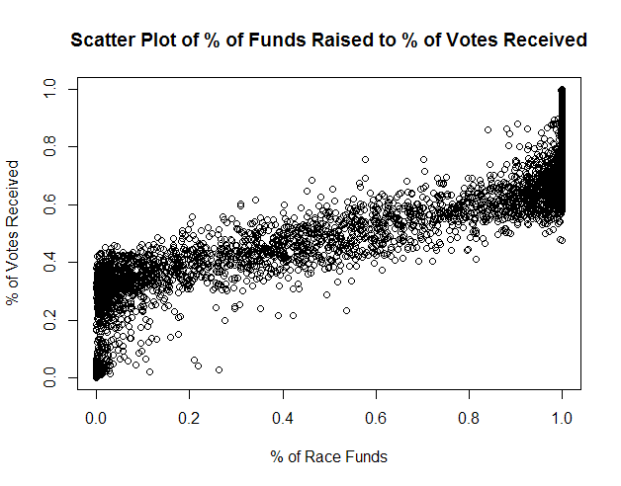
Funding is highly correlated with electoral success:

Slide 11
Association rules show the same pattern, with a caveat…
Rule | Support | Confidence | Description
{CANDTOTALLEVEL=Very Low} => {WINNER=0} | 0.301615 | 0.724322104 | 72.4% of candidates who raised very low amounts lost
{WINNER=0} => {CANDTOTALLEVEL=Very Low} | 0.301615 | 0.748556386 | 74.9% of losing candidates raised very low amounts of money
{CANDTOTALLEVEL=High} => {WINNER=1} | 0.055601177 | 0.779002876 | 77.9% of candidates who raised a high amount won
{INCUMBENT=1} => {WINNER=1} | 0.509512078 | 0.953451146 | 95.3% of incumbents won reelection
{WINNER=1} => {INCUMBENT=1} | 0.509512078 | 0.853352436 | 85.3% of winners were incumbents
{CANDTOTALLEVEL=Very Low} => {INCUMBENT=0} | 0.314309177 | 0.754806902 | 75.5% of candidates who raised a very low amount were challengers
{INCUMBENT=0} => {CANDTOTALLEVEL=Very Low} | 0.314309177 | 0.675044092 | 67.5% of challengers raised a very low amount of funding
{CANDTOTALLEVEL=High} => {INCUMBENT=1} | 0.05460891 | 0.765100671 | 76.5% of candidates who raised a high amount of funding were incumbents
{CANDTOTALLEVEL=Mid-High} => {INCUMBENT=1} | 0.111510299 | 0.70116179 | 70.1% of candidates who raised a mid-high amount were incumbents
Difficult to separate out effects of Incumbent variable from Winner variable

Slide 12
Models
Decision Tree
Naive Bayes
Lazy Model: K-nearest Neighbor (KNN)

Slide 13
Evaluation Metrics
accuracy: % of predictions that are right
precision: true positives
recall
F-measure: consider both precision & recall

Slide 14
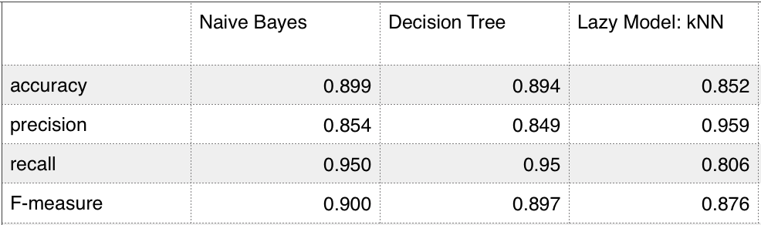
5-folds cross validation result

Slide 15
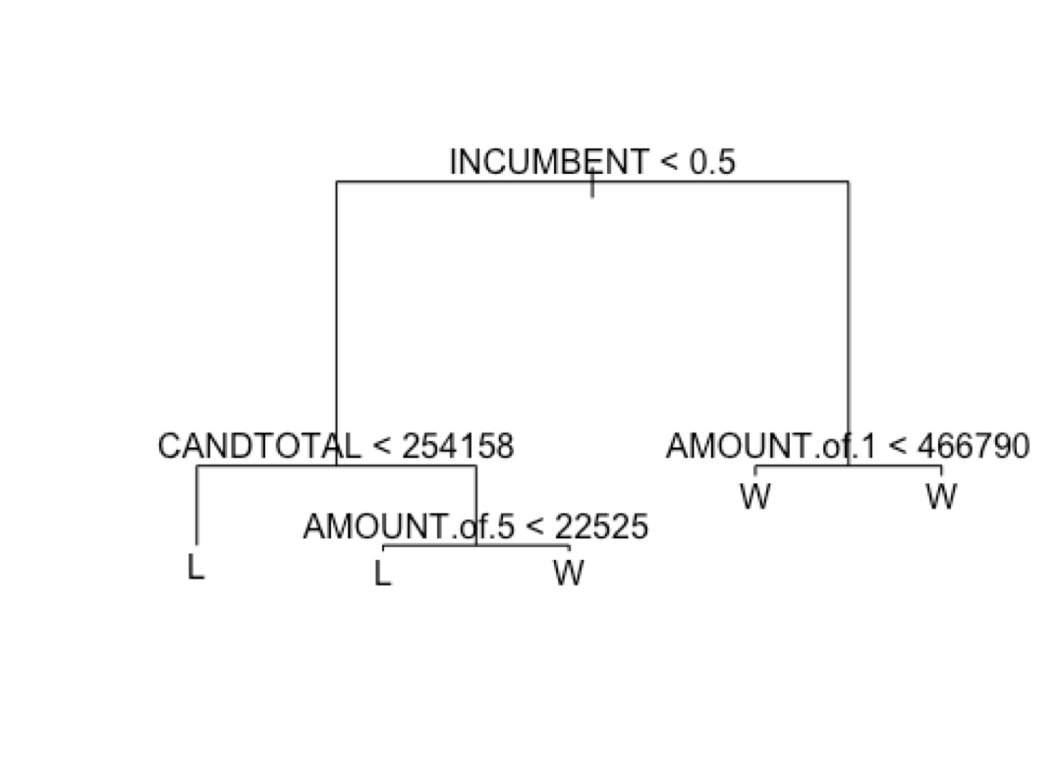
Another Interesting Thing
10-folds cross validation result

Slide 16
Question 2:
Do campaign contributions predict an industry’s performance?

Slide 17
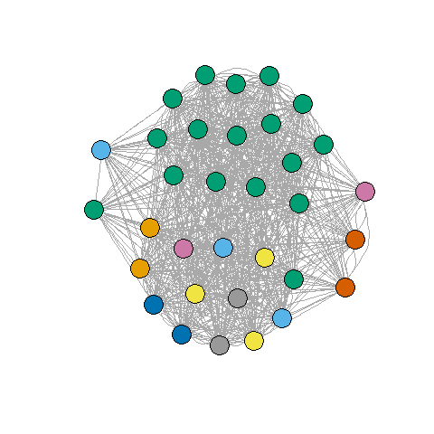
We couldn’t really answer this question…
Data weren’t binned in a manner conducive to answering it
No stock data for some major contributors (nonprofits, not publicly traded, other)
Green cluster: candidates primarily supported by nonprofits and the financial industry.

Slide 18
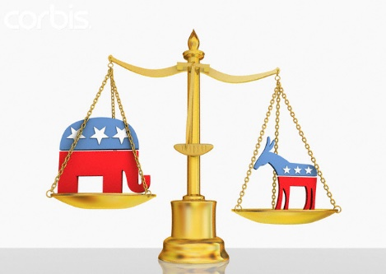
Party Disparity

Slide 19
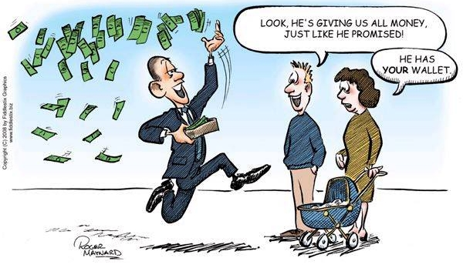

Slide 20
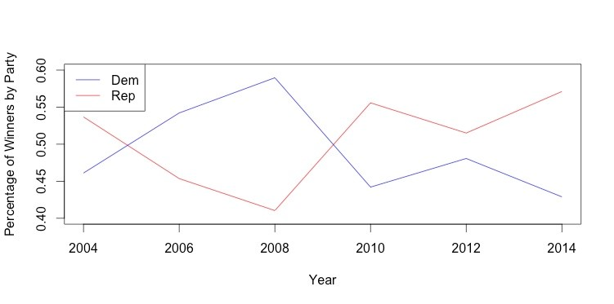

Slide 21
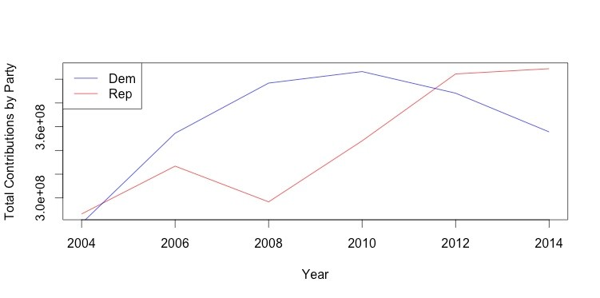

Slide 23
Opportunities for Future Research

Slide 24
What could we do later on?
Look into Presidential Campaigns
This would involve getting more data
Closely examine difference between Senate and House candidates
This project lumped them together
Look at differences from state to state

Slide 25
Wrapping it Up

Slide 26
The evolution of our Question
Initial Ideas:
Do Political Contributes by sectors affect whether candidates win?
Do election results had any specific impact on the market as a whole.?
Resulting Analyses
The idea morphed into looking at total campaign contributions
Stock Data didn’t seem to affect election results.
An interesting paradox is the Financial Crisis

Slide 27
Some takeaways
Many of our conclusions supported already expected conclusions, but no major breakthroughs that were uncovered
Stocks aren’t significantly affected by election results
Non-incumbent candidates, regardless of party, are dead-money

Slide 28
A Cool Visualization
http://cs-sys-1.uis.georgetown.edu/~hw271/ds_visualization/USCongressionalDistrict/index.html

